Slide 1


Introduction to Statistical Static Timing Analysis
Statistical Static Timing Analysis (SSTA) is a technique used in digital circuit design to analyze timing performance and ensure reliable operation. It is essential for designing high-performance and low-power circuits that meet stringent timing requirements.
by 峰 喬

Slide 2

Importance of Timing Analysis in Digital Design
Timing analysis is crucial in digital design to ensure that signals propagate through the circuit within specified time limits. Timing violations can lead to incorrect circuit operation, data corruption, and system failure.
Performance
Reliability
Timing analysis helps optimize circuit performance by identifying critical paths and bottlenecks that limit signal propagation speed.
It ensures that the circuit operates reliably by analyzing timing margins and identifying potential hazards that could cause malfunctions.
Power Consumption
Timing analysis can be used to optimize power consumption by identifying areas where clock speeds can be reduced or signal paths optimized.

Slide 3

Timing Constraints and Objectives
Timing constraints define the acceptable timing behavior of a digital circuit. They specify the maximum allowable delay for signals to propagate through the circuit and the minimum time allowed between signal transitions.
1
Setup Time
2
Hold Time
The minimum time a data signal must be stable before the clock edge arrives.
The minimum time a data signal must be stable after the clock edge arrives.
3
Clock Period
The time between two consecutive clock edges.

Slide 4
Modeling Variations in Circuit Parameters
SSTA takes into account variations in circuit parameters, such as transistor sizes, wire lengths, and process variations, which can significantly affect timing performance. These variations are modeled using statistical distributions.
Process Variations
Temperature Variations
Voltage Variations
Variations in manufacturing processes that affect transistor characteristics.
Variations in operating temperature that affect transistor speeds and delays.
Variations in supply voltage that affect transistor performance.

Slide 5
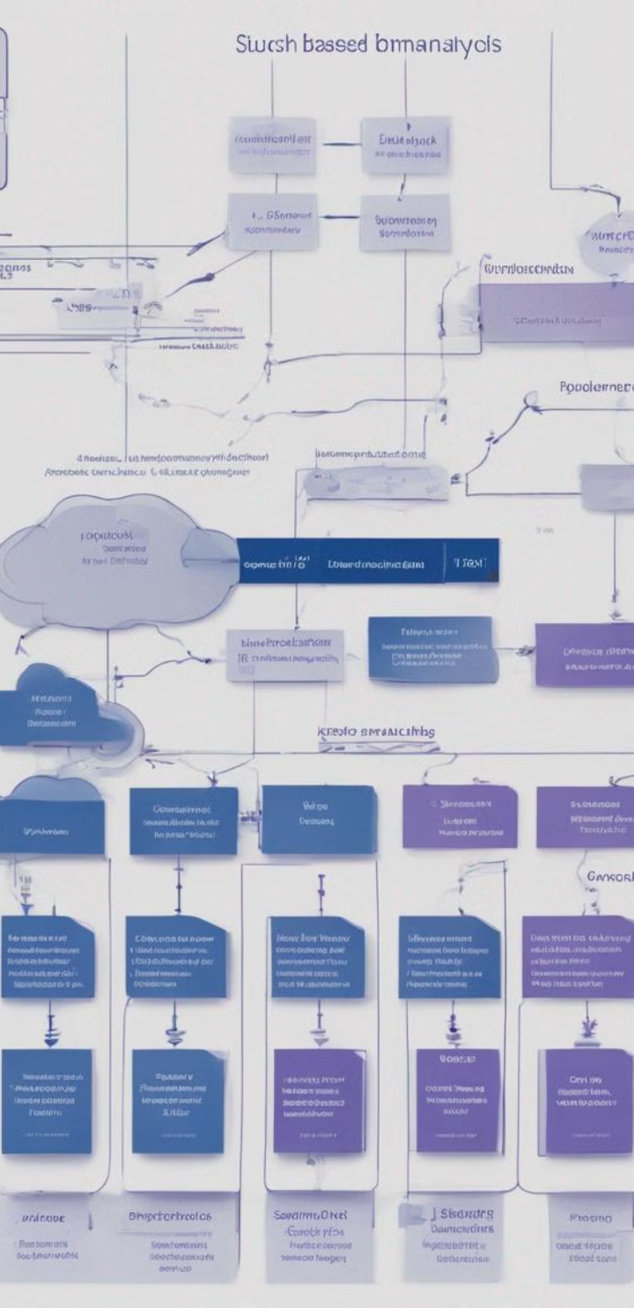



Statistical Timing Analysis Methodologies
SSTA uses various methodologies to analyze timing performance, taking into account variations in circuit parameters and their impact on signal propagation delays.
Path-Based Analysis
Analyzes the timing of individual paths through the circuit.
Statistical Timing Simulation
Simulates circuit behavior using statistical models of variations.
Corner-Based Analysis
Analyzes the circuit at different corners of process, voltage, and temperature variations.

Slide 6
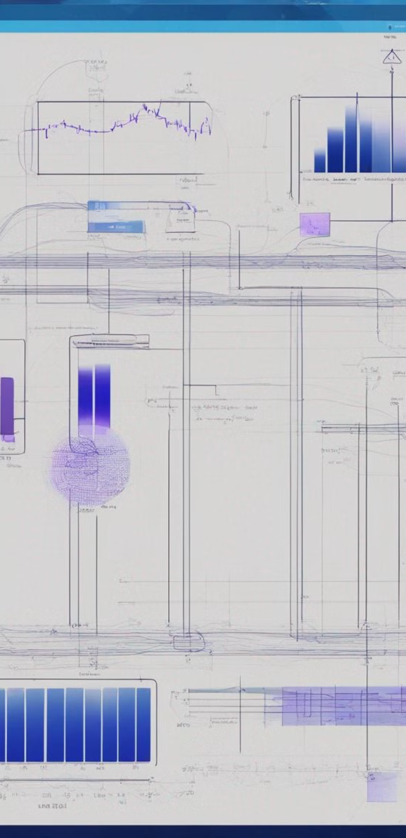
Monte Carlo Simulation Techniques
Monte Carlo simulation is a widely used technique in SSTA. It involves randomly sampling variations in circuit parameters and simulating the circuit behavior to obtain a statistical distribution of timing performance.
Advantages
Accurate results, handles complex variations.
Disadvantages
Computational intensive, may require large sample sizes.

Slide 7




Sensitivity Analysis and Timing Budgeting
Sensitivity analysis helps identify critical paths and parameters that have the greatest impact on timing performance. Timing budgeting allocates timing margins to different parts of the circuit based on their sensitivity.
Parameter Optimization
Identify parameters that have the most significant impact on timing.
Timing Margin Allocation
Allocate timing margins to critical paths based on their sensitivity.
Performance Monitoring
Track timing performance and identify areas for improvement.

Slide 8

Timing Closure and Optimization Strategies
Timing closure refers to the process of ensuring that all timing constraints are met. Optimization strategies are employed to improve timing performance and achieve timing closure.
1
Buffer Insertion
Insert buffers to reduce signal delay and improve timing.
2
Sizing
Adjust transistor sizes to optimize delay and drive capability.
3
Path Balancing
Balance the timing of different paths to minimize critical path delay.

Slide 9

Challenges and Limitations of SSTA
SSTA faces challenges in accurately modeling complex circuit behavior, dealing with large variations in parameters, and ensuring efficient analysis of large circuits.
1
Model Complexity
2
Computational Complexity
3
Accuracy Trade-offs
Accurately modeling circuit behavior with all variations is difficult.
SSTA can be computationally expensive, especially for large circuits.
There are trade-offs between accuracy and computational cost.

Slide 10
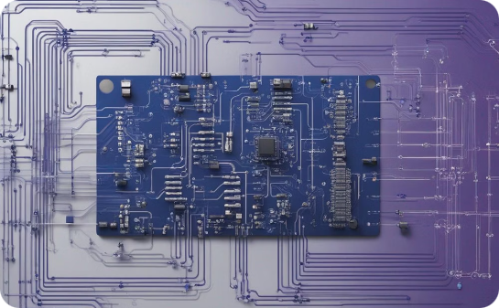


Trends and Future Directions in SSTA
SSTA is continuously evolving with advancements in algorithms, modeling techniques, and software tools. Future directions include improved accuracy, efficiency, and integration with other design methodologies.
Improved Statistical Modeling
Advanced Visualization and Analysis
Integration with Design Flows
More accurate models for capturing complex circuit behavior and variations.
Seamless integration of SSTA into design flows for more efficient and automated analysis.
Enhanced tools for visualizing and analyzing SSTA results for better insights.

Slide 11
🙋 Q & A

